Slide 1
ARRAY OF STRUCTURES

Slide 2
INTRODUCTION
Structure is used to store information of one particular object.
What if we want to store more than one object????
Ans is : Array of structures

Slide 3
Syntax
Struct book {
char bname[20];
int pages;
char author [20];
float price;
}b1[100];
To access page of third book:
b1[2].pages

Slide 4
How do we initialize array of structures
Intialization after declaration
Syntax:
Struct book{
char bname [20];
int pages;
float price;
char author[20];
}b1[3]={
{“Database”,345,456.89,”acv”},
{“C”,789,678.90,”fgc”},
{“C++”,789,777.89,”ggg”}
};

Slide 5
Initialization in Main
struct Book {
char bname[20];
int pages;
char author[20];
float price;
};
void main()
{ struct Book b1[3] = {
{"Let us C",700,"YPK",300.00},
{"Wings of Fire",500,"Abdul Kalam",350.00},
{"Complete C",1200,"Herbt Schildt",450.00}
};
}

Slide 6
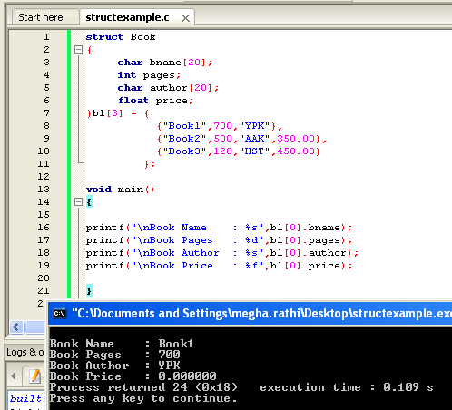
All Structure Members need not be initialized

Slide 7
Default Values
Default values for different datatypes:
Integer : 0
Float: 0.0000
Character : Blank

Slide 8
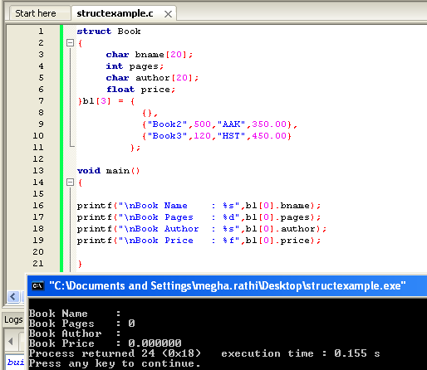
Example

Slide 9
Practice Questions
WAP using array of structures to create a record of 50 student. Record contain attributes: student name, id, and percentage. Also print created structure.
Store information of 10 students using structure (name,roll_no,marks). Input values at runtime and rollno updated automatically.
Output should be like
For Rollno 1
Enter name:
Enter marks:
For roll no 2:
……

Slide 10
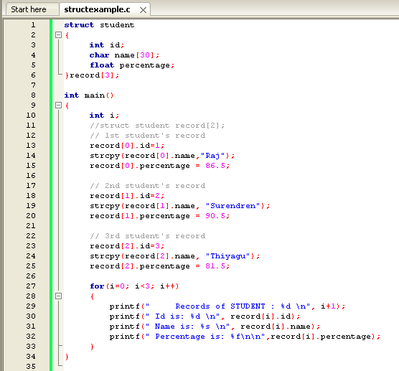
Solution (1)

Slide 11
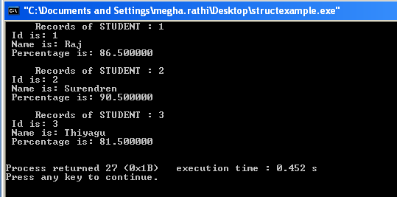
Output

Slide 12
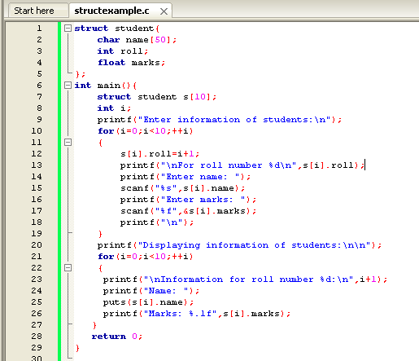
Declaring many structure variable in C

Slide 13
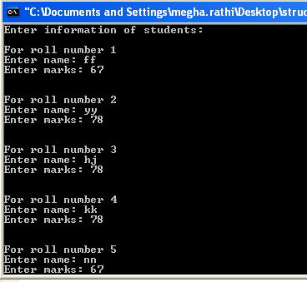

Slide 14
Practice Question (1)
The correct syntax to access the member of the ith structure in the array of structures is? Assuming: struct temp { int b; }s[50]; a) s.b.[i]; b) s.[i].b; c) s.b[i]; d) s[i].b;

Slide 15
(2)
#include <stdio.h>
struct temp
{
int a;
int b;
int c;
};
main()
{
struct temp p[] = {{1, 2, 3}, {4, 5, 6}, {7, 8, 9}};
}
a) No Compile time error, generates an array of structure of size 3 b) No Compile time error, generates an array of structure of size 9 c) Compile time error, illegal declaration of a multidimensional array d) Compile time error, illegal assignment to members of structure

Slide 16
(3)
What is the output of this C code? (Assuming size of int be 4)
#include <stdio.h>
struct temp
{
int a;
int b;
int c;
} p[] = {0};
main()
{
printf("%d", sizeof(p));
}
a) 4 b) 12 c) 16 d) Can’t be estimated due to ambigous initialization of array

Slide 17
(4)
What is the output of this C code?
#include <stdio.h>
struct student
{
};
void main()
{
struct student s[2];
printf("%d", sizeof(s));
}
a) 2 b) 4 c) 8 d) 0

Slide 18
Answer
(1) D
(2) A
(3) B
(4) D

Slide 19
Union
Unions are quite similar to the structures in C. Union is also a derived type as structure. Union can be defined in same manner as structures just the keyword used in defining union in union where keyword used in defining structure was struct.
Syntax:
union car{
char name[50];
int price;
};

Slide 20
Union Variables
union car{
char name[50];
int price;
}c1, c2, c3;
OR
union car{
char name[50];
int price; };
-------Inside Function----------- union car c1, c2, c3;

Slide 21
Difference between Union and structure
First difference is in memory allocation
Second difference is in handling members of union.

Slide 22
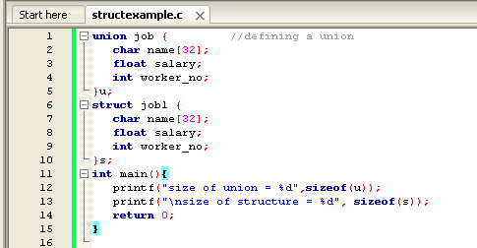
Example

Slide 23
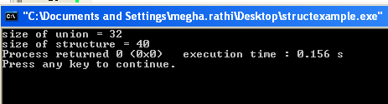
Output

Slide 24
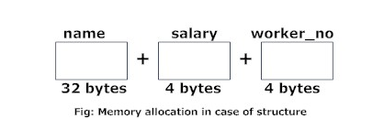
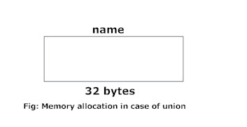

Slide 25
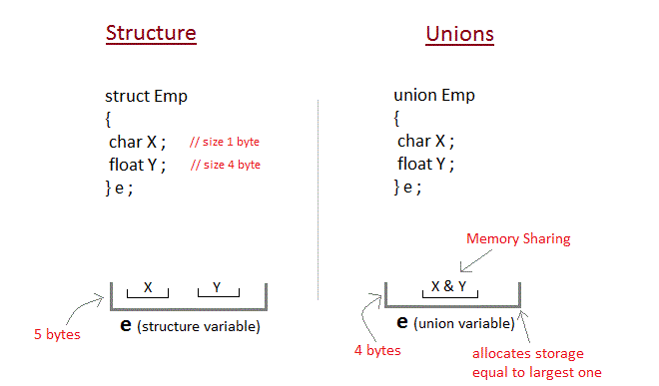

Slide 26
A union may contain many members of different types, it cannot handle all the members at same time.
union item {
int m;
float x;
char c;
}It1;
This union contains three members each with a different data type. However only one of them can be used at a time. This is due to the fact that only one location is allocated for a union variable, irrespective of its size

Slide 27
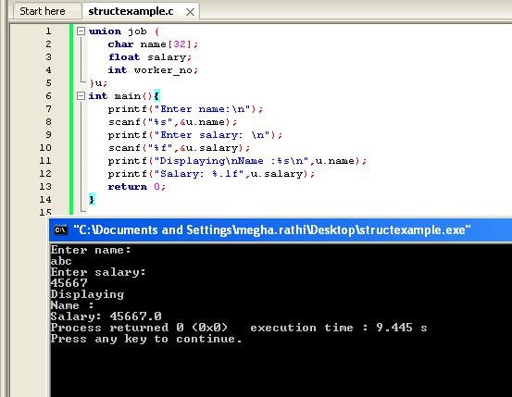
Example

Slide 28
Why the above output
Initially, “abc” will be stored in u.name and other members of union will contain garbage value. But when user enters value of salary, 45667 will be stored in u.salary and other members will contain garbage value. Thus in output, salary is printed accurately but, name displays some random string or blank value.

Slide 29
Practice Questions
WAP in C for creating the record of student (name, subject,percentage) using union.

Slide 30
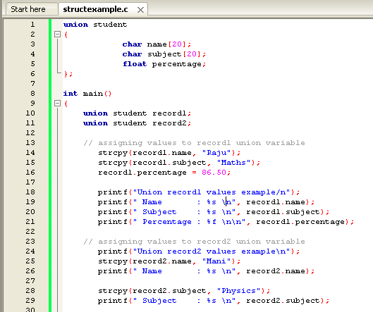

Slide 31
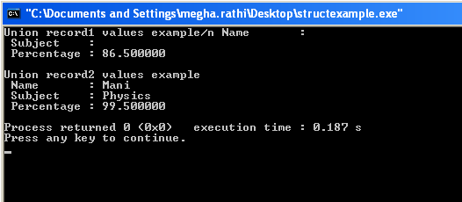
Output

Slide 32
C Storage Classes
Storage class define the scope and lifetime of variable/function.
Four different storage classes in C Progrem:
Auto
Register
Static
extern

Slide 33
auto
This is the default storage class for all variables declared inside a function or a block.
Keyword auto is rarely used while writing a C Program.
Auto variables can only be accessed within the block/function they have been declared and not outside them.
Automatic variables can also be called local variables because they are local to function. By default they are assigned garbage value by compiler.

Slide 34
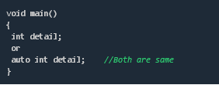
auto

Slide 35
extern
Extern storage class simply tells us that variable is defined elsewhere and not within the same block where it is used.
So extern variable is nothing but a global variable initialized with a legal value where it is declared in order to be used elsewhere.
Extern keyword is used before a variable to inform the compiler that this variable is declared somewhere else.

Slide 36
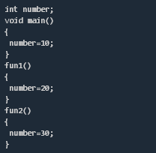
extern

Slide 37
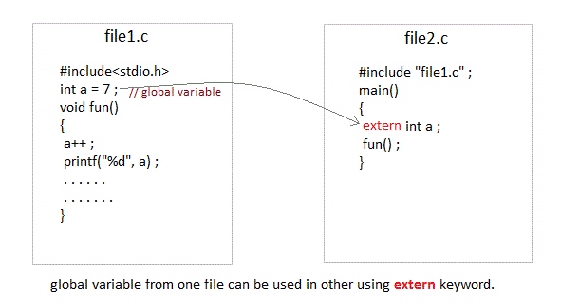

Slide 38

Problem when extern is not used

Slide 39
static
Static variables have a property of preserving their value even after they are out of scope.
They are initialized only once and exist till the termination of program.
By default they are assigned the value ‘0’ by the compiler.

Slide 40
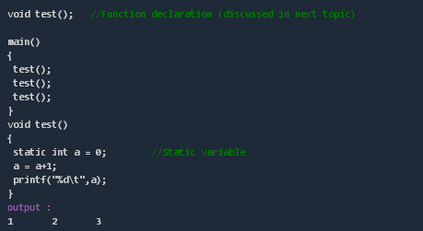
static

Slide 41
register
This storage class declares register variables which have the same functionality as that of the auto variables. The only difference is that the compiler tries to store these variables in the register of the microprocessor if a free register is available.
This makes the use of register variables to be much faster than that of the variables stored in the memory during the runtime of the program. If a free register is not available, these are then stored in the memory only.
An important and interesting point to be noted here is that we cannot obtain the address of a register variable using pointers.
Syntax :
register int number;

Slide 42
